Slide 1



WAVECON
TELECOM ANALYSIS
Presented By: Nandini

Slide 2



Agenda
Company Overview
Business Problem
Ad-hoc requests & Insights
Market Share

Slide 3



Company Overview
Wavecon is a leading telecom provider in India, known for reliable and innovative services. In May 2022, Wavecon launched 5G services across 15 major cities to offer high-speed connectivity and enhance user experience.

Slide 4




Business Problem
After launching 5G, Wavecon noticed a decline in revenue and active users. The goal is to analyze 5G's impact, identify underperforming KPIs, assess plan performance, and decide which plans to continue or discontinue.

Slide 5










Data Summary (Year-2022)
< 5G
Jan
Feb
Mar
Apr
May
5G Implementation
> 5G
June
July
Aug
Sep

Slide 6

Ad-hoc Analysis
1.Evaluating the overall impact of the 5G launch on revenue.
2.Identifying underperforming KPIs post-launch.
3.Comparing plan performance to identify top performers and underperformers.
4.Assessing which plans were most impacted by the 5G launch to decide whether to keep or discontinue them.
5.Understanding reasons behind plan discontinuation after the 5G launch.

Slide 7
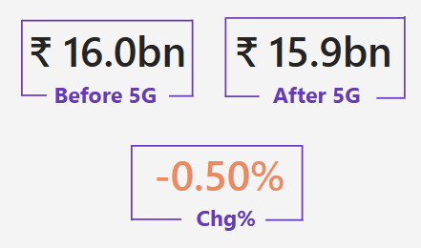
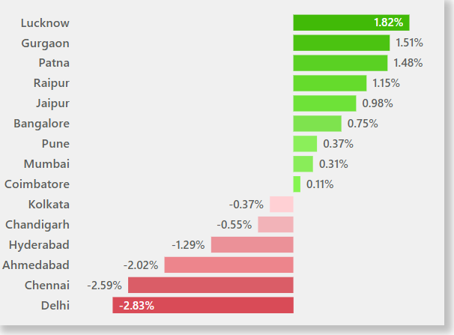


1.Impact of the 5G launch on revenue.
Revenue decreased slightly from ₹16.0bn to ₹15.9bn after 5G, reflecting a 0.50% decline.
Some cities gained revenue: Lucknow (+₹12M, +1.82%) and Gurgaon(1.51%).
Major cities like Delhi (-₹56M, -2.83%) and Chennai (-₹39M, -2.59%) saw declines.
📌 Takeaway: The 5G launch had a neutral to slightly negative impact on revenue. Focus should be placed on improving performance in underperforming regions.

Slide 8
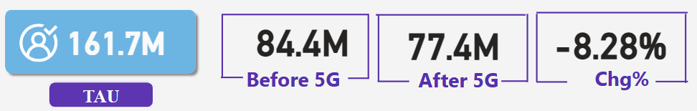
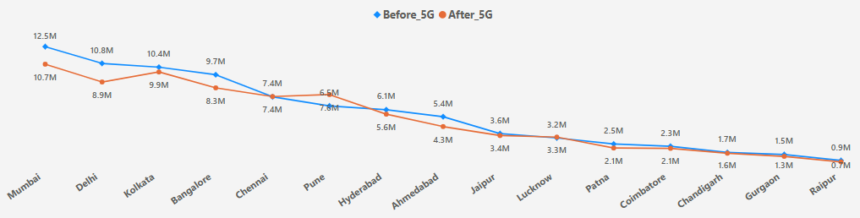

2.Identifying underperforming KPIs post-launch.
TAU (Total Active Users)
Overview:
After the 5G launch, active users decreased by 8.28%, from 84.4M to 77.4M.
City Performance:
Only Pune showed a positive trend with increasing active users.
Major cities like Mumbai and Delhi saw the biggest drops.
General Trend:
Most cities are facing declines, pointing to adaptation challenges or network issues.
📌 Takeaway: The 5G launch caused a decline in active users across most cities. Focus on improving network quality and user experience in underperforming areas.

Slide 9


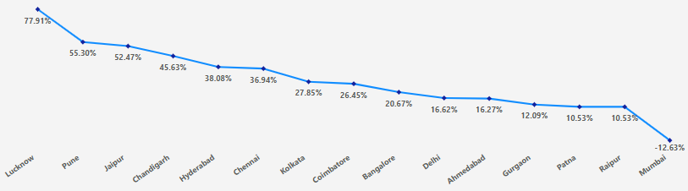

TUsU (Total Unsubscribed Users)
Overview:
After the 5G launch, unsubscribed users increased by 23.5%, from 5.6M to 7.0M.
City Performance:
Lucknow: Highest increase in TUsU (77.9%), indicating major dissatisfaction.
Pune: Substantial growth despite positive trend in active users.
Mumbai: Least affected, showing better retention.
General Trend:
The 5G launch led to a significant rise in TUsU, particularly in cities like Lucknow and Pune.
📌 Takeaway: Focus on enhancing network quality and user satisfaction in high-churn cities like Lucknow and Pune.

Slide 10
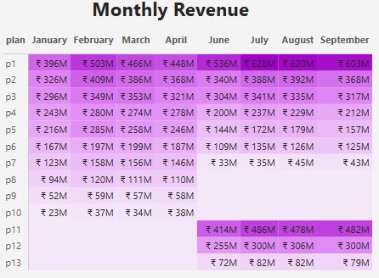
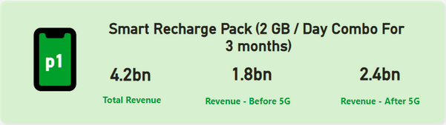
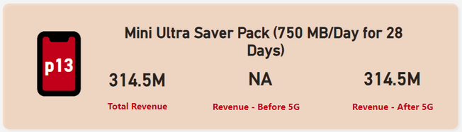
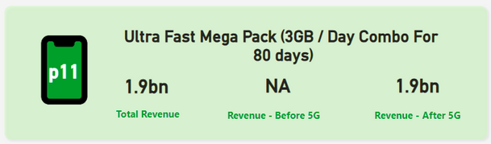
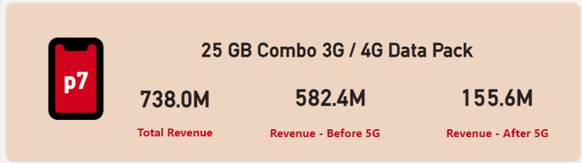

3.Plan performance after 5G in terms of revenue.
✅ Popular Plans
❌ Underutilized Plans
Plans with higher data, like P1 & P11, are preferred post-5G, possibly because customers seek larger data packs for smoother, faster experiences.
Lower data plans like P7 & P13 are losing popularity post-5G, as they don't meet user needs for higher data, leading to revenue decline.
📌 Takeaway: Promote popular plans (P1 & P11) with more data to meet user demand, and improve or replace low-data plans (P7 & P13) to avoid losing revenue.

Slide 11

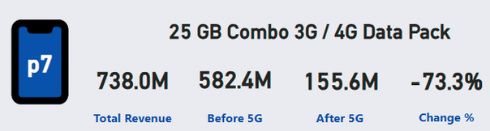
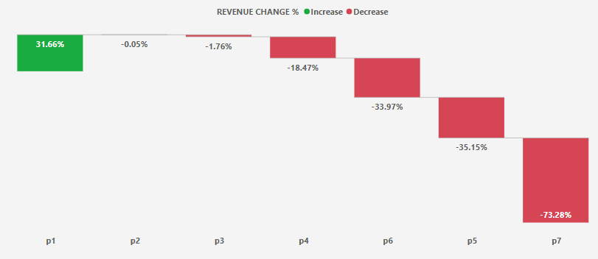
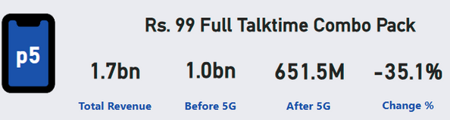

4.Plan affected largely by 5G launch.
Revenue Drop: 73.3% decrease.
Reason: Likely because customers don’t find this 3G/4G plan valuable in a 5G market.
Revenue Drop: 35.1% decrease.
Reason: Probably because talktime plans are becoming less popular as people prefer data plans.
📌 Takeaway: Improve or replace struggling plans like P7 and P5 by adding 5G support or better features, and focus on promoting plans that are doing well and fit what customers want in the 5G market.

Slide 12
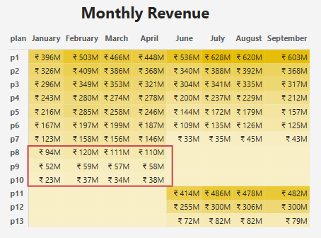
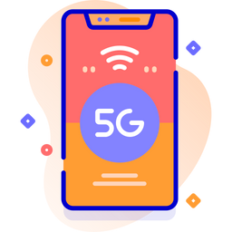
5.Discontinued plan after 5G launch.
PLAN | PLAN DESCRIPTION | REVENUE AFTER 5G
P8 | Daily Saviour - 1 GB / Day, 1 Day validity | 434M
P9 | Combo TopUp - 14.95 Talktime & 300 MB data | 227M
P10 | Big Combo Pack - 6 GB / Day, 3 Days validity | 131M
Plan P8: Offers only 1 GB/day, which may be insufficient for 5G users wanting faster, more data-heavy experiences.
Plan P9: Provides just 300 MB of data with talktime, but most users now prefer more data over talktime.
Plan P10: The 3-day validity is too short and lacks value compared to other plans with more data or longer validity.
📌 Takeaway: These three plans (P8, P9, P10) are outdated for the 5G market. To avoid losing revenue, they should be replaced with new packs offering more data, better validity, or attractive features.

Slide 13

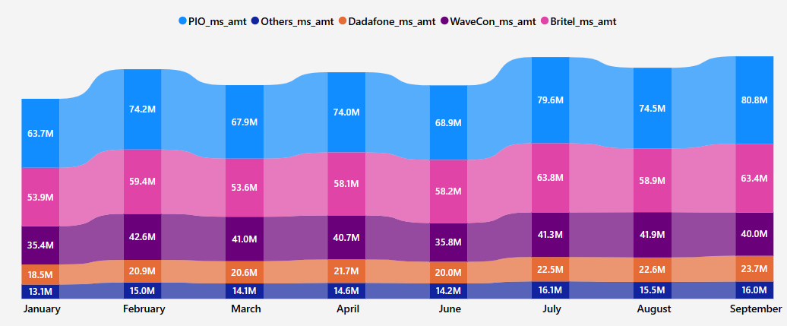

Market Share
Wavecon holds the third position in the market, which indicates strong competition.
To improve its position, Wavecon needs to enhance its 5G plans, attract more customers, and retain existing ones by offering better value and innovative packages.

Slide 14





ThankYou
Presented By: Nandini

